Slide 1
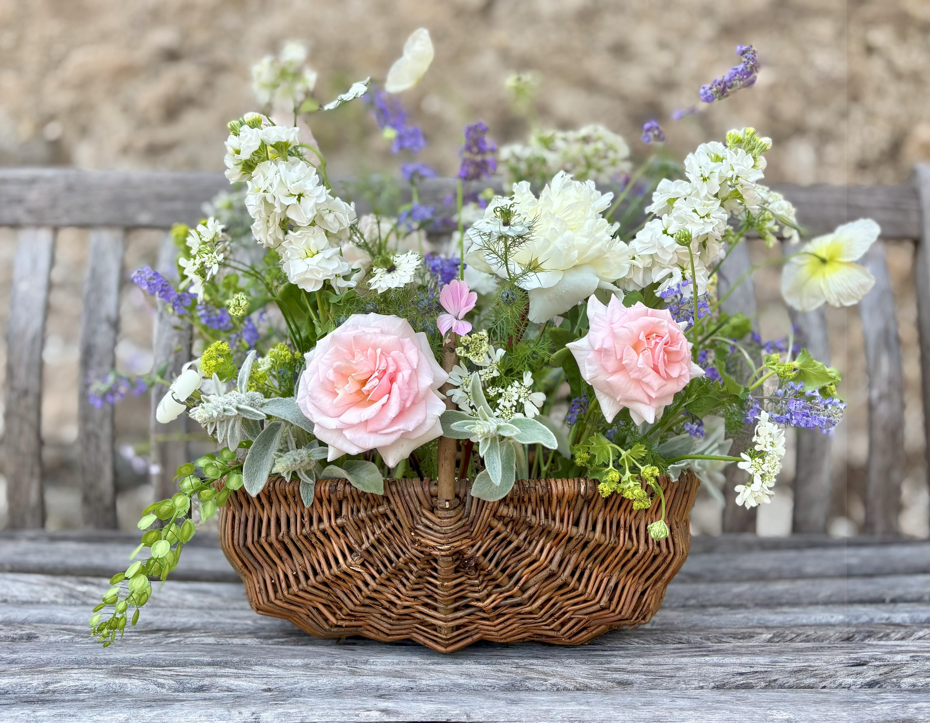
Sympathy
Flowers
Blossoms & Blooms Floral Studio

Slide 2
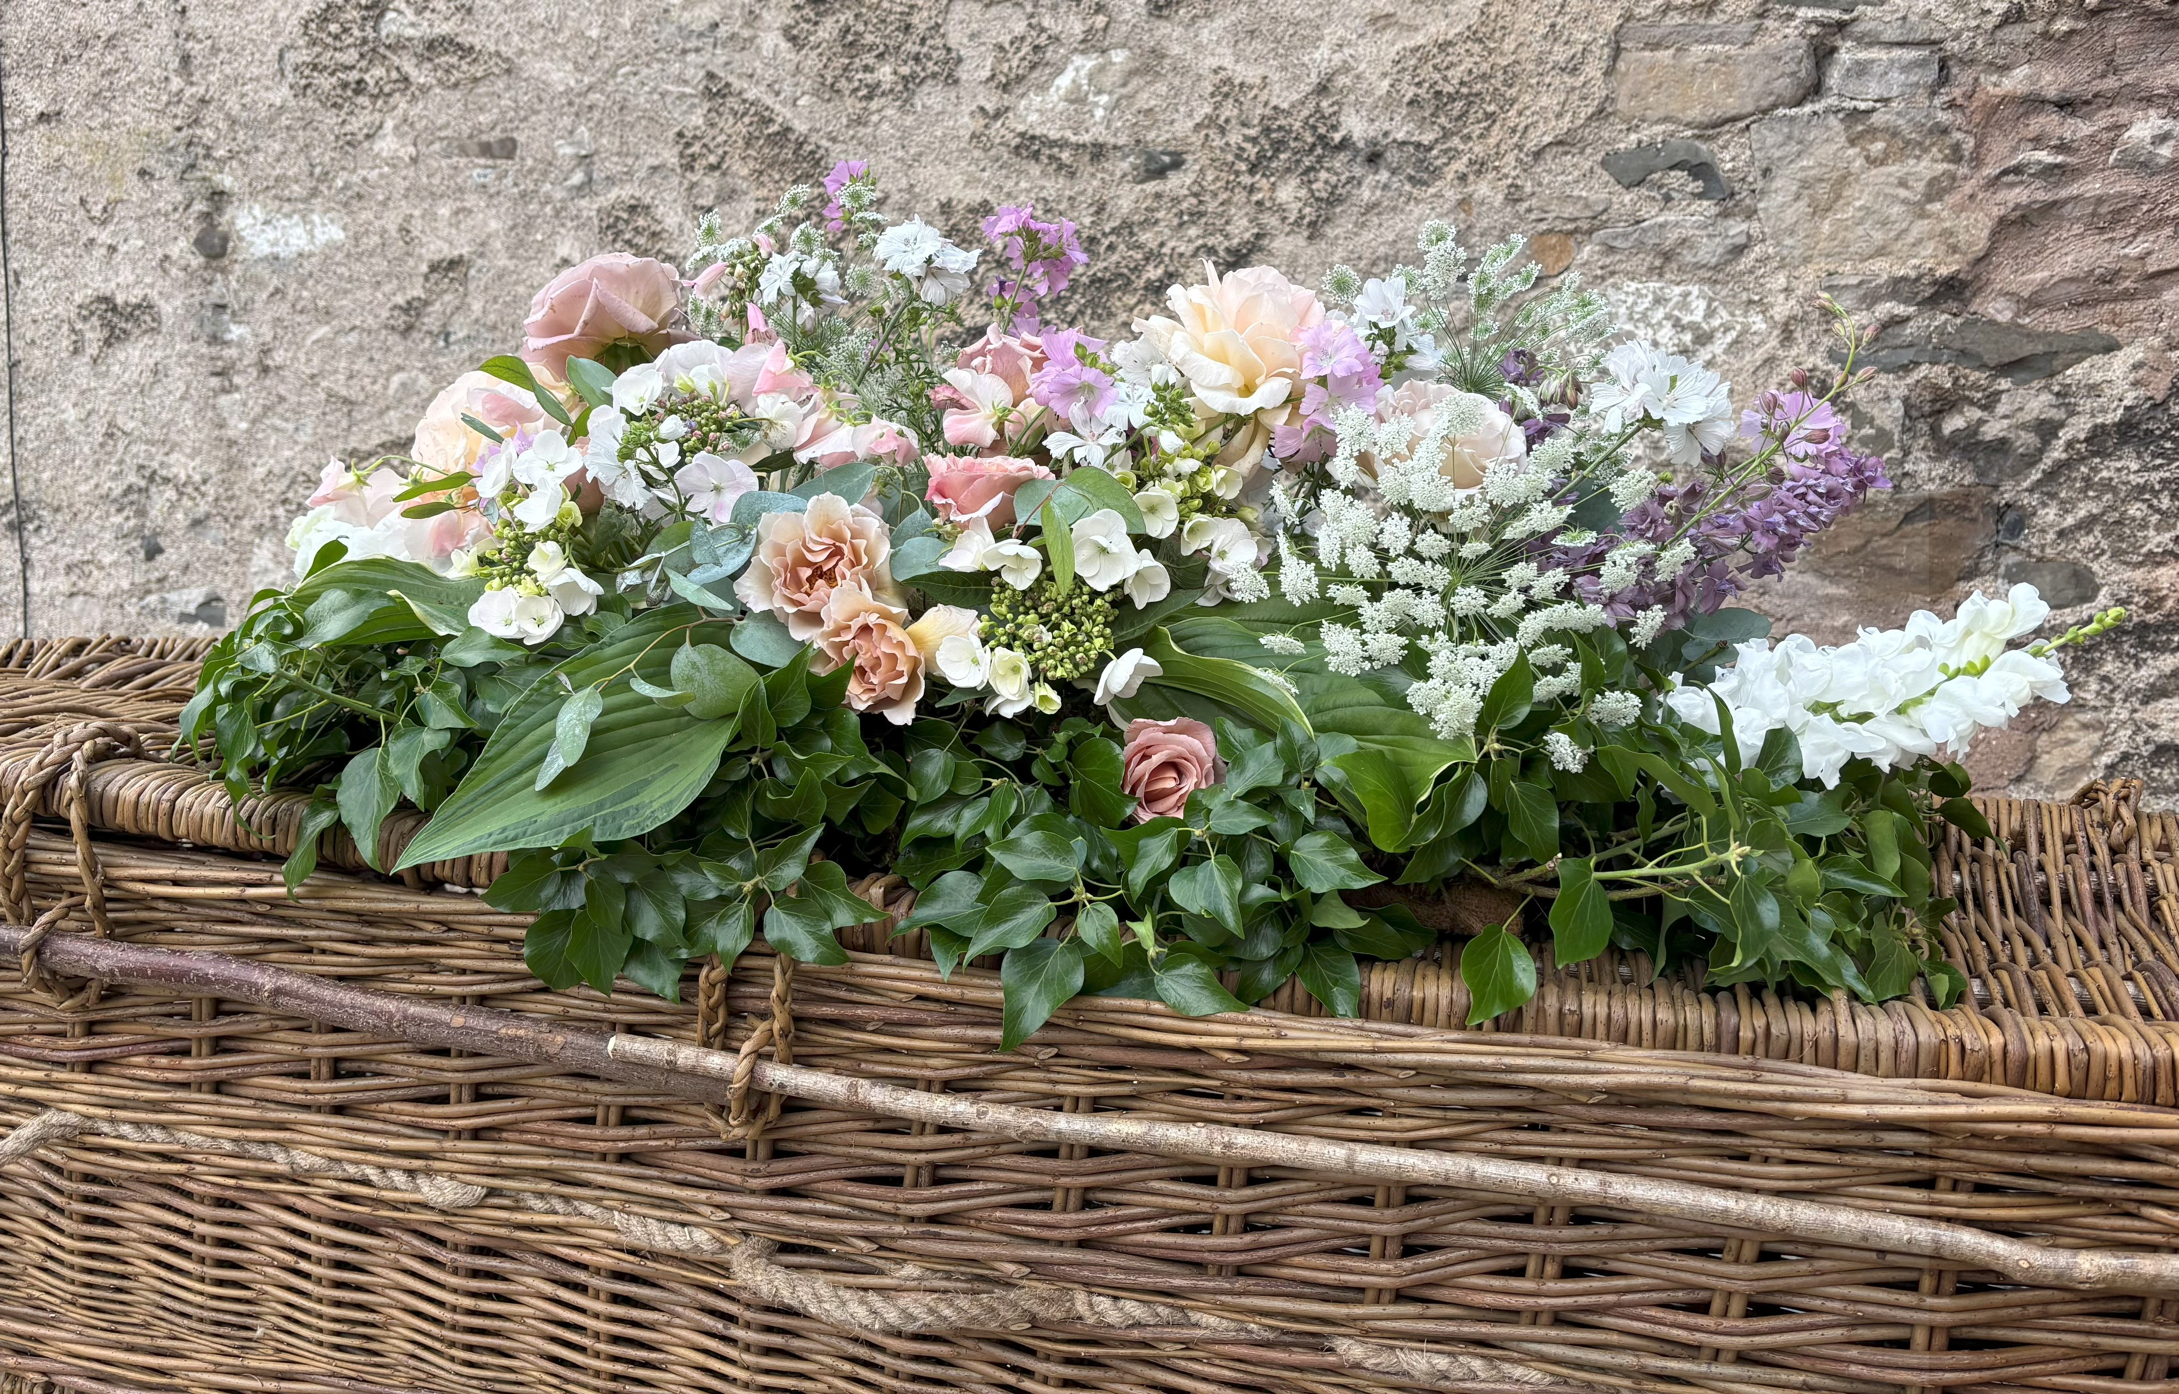
The Flowers
My sympathy flowers are loose and natural floral arrangements, using flowers and foliage from British growers wherever possible.
I like to reflect the life being honoured by creating something personal to you, your family and your loved one. I am here to listen and advise on style, size, colours and flowers to ensure the perfect tribute.
I deliver floral tributes directly to funeral directors, funeral homes, crematoriums, churches or private addresses from my studio in Cumbria.

Slide 3
The Tributes
01 Casket Spray
A natural display of foliage and flowers which will sit atop the casket. A small amount of drape is usual to soften the edges of the casket.
All designs are bespoke and start from £155 (prices are dependent on density and type of flower).

Slide 4
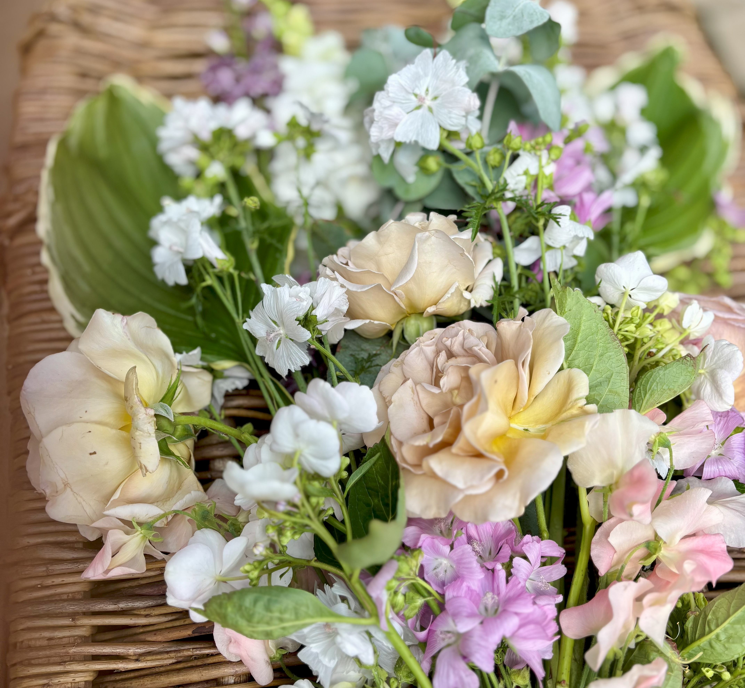
The Tributes
02 Casket Sheaf
A hand-tied natural display of foliage and flowers which will sit atop the casket.
All designs are bespoke and start from £85 (prices are dependent on density and type of flower).

Slide 5
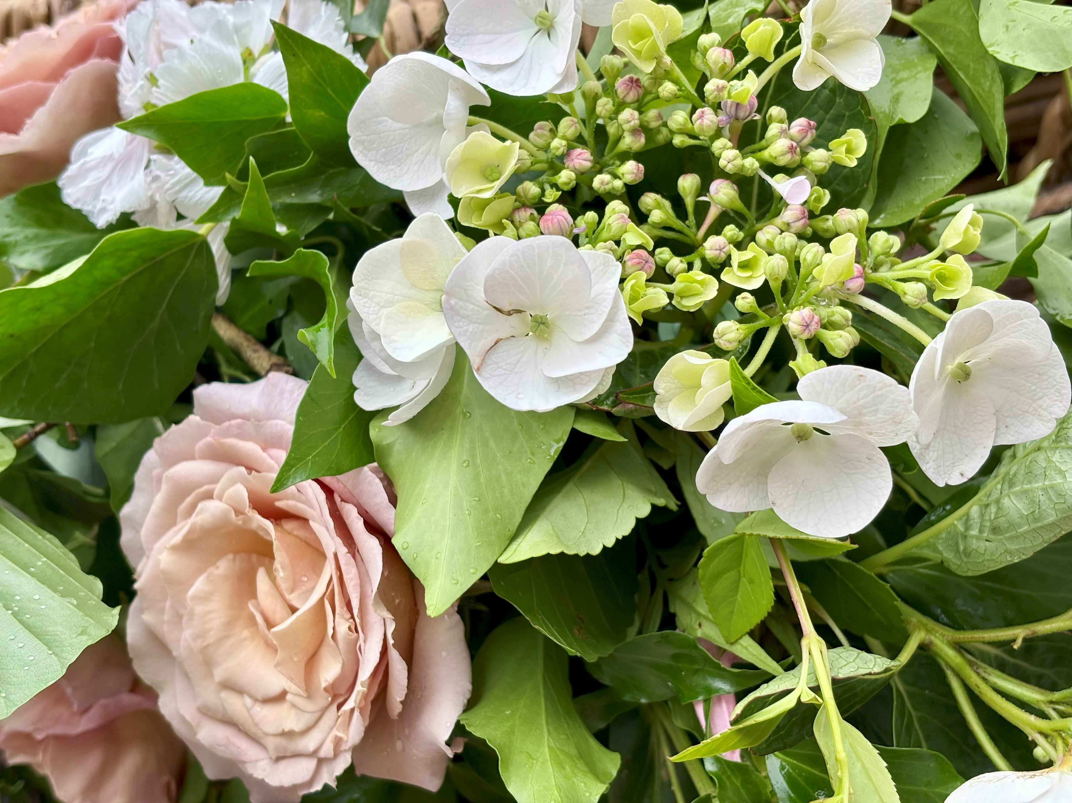
The Tributes
03 Pedestal Designs
A loose, natural and abundant display of flowers and foliage to sit atop adjustable stands or within an urn.
All designs are bespoke and start from £200 (prices are dependent on density and type of flower).

Slide 6
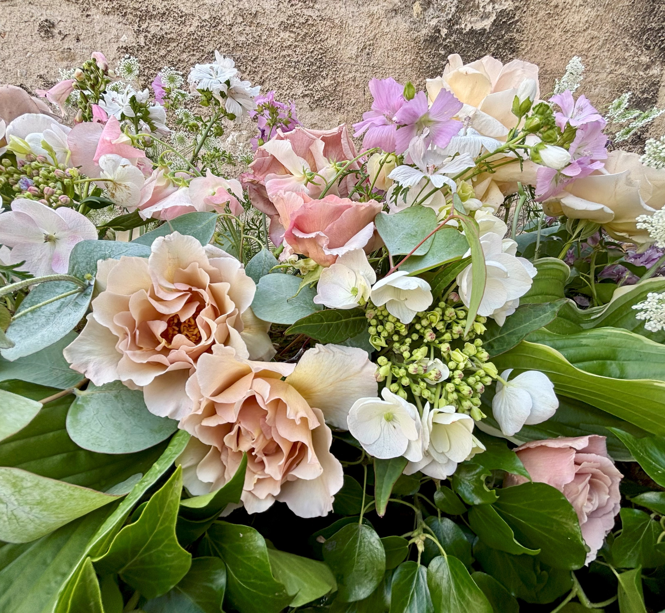
The Tributes
04 Shaped Tributes
All designs are bespoke and created within wooden or willow frames. I never use floral foam in my designs. Popular designs include:
Circular Wreath from £90
Heart Wreath from £100
Cross Wreath from £150
Floral Basket from £150
Prices are dependent on density and type of flower.

Slide 7
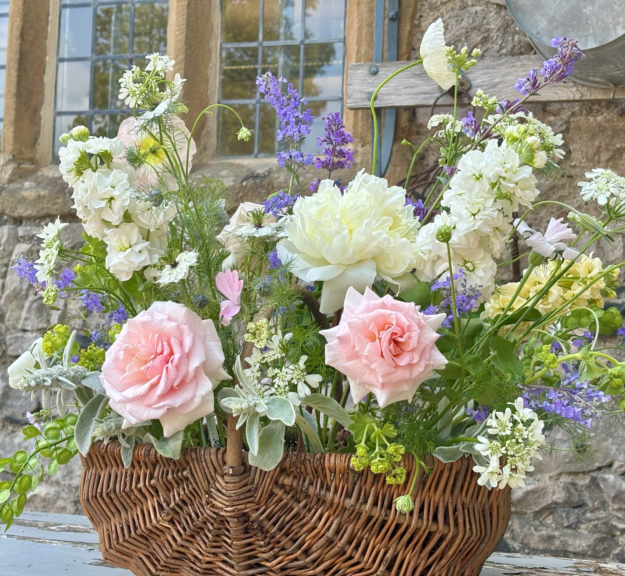
The Tributes
05 Other Tributes
All my designs are bespoke and I am here to discuss any requirements you have in order to create something personal to you, your family and your loved one.
I can dress a table within a church or crematorium, create a wicker basket display or talk through any particular design you have in mind. When you’re ready, please don’t hesitate to get in touch.

Slide 9
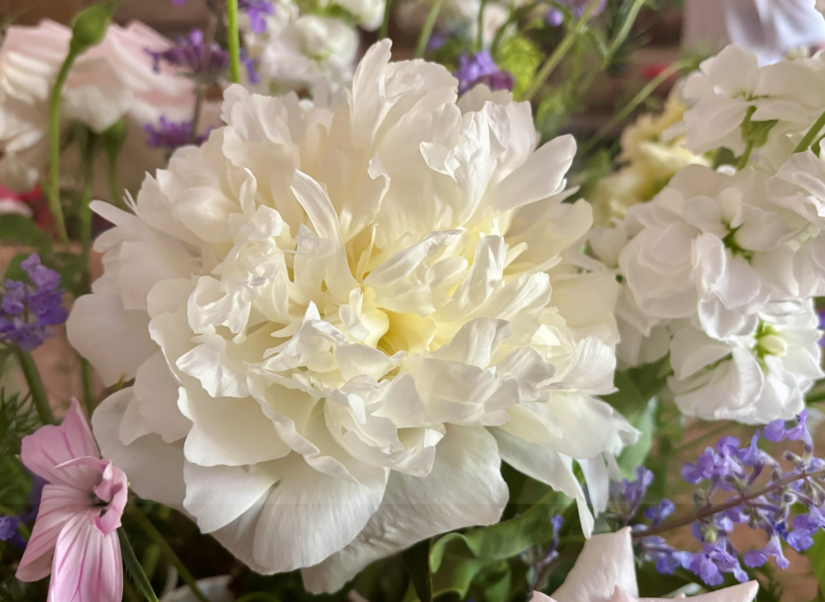
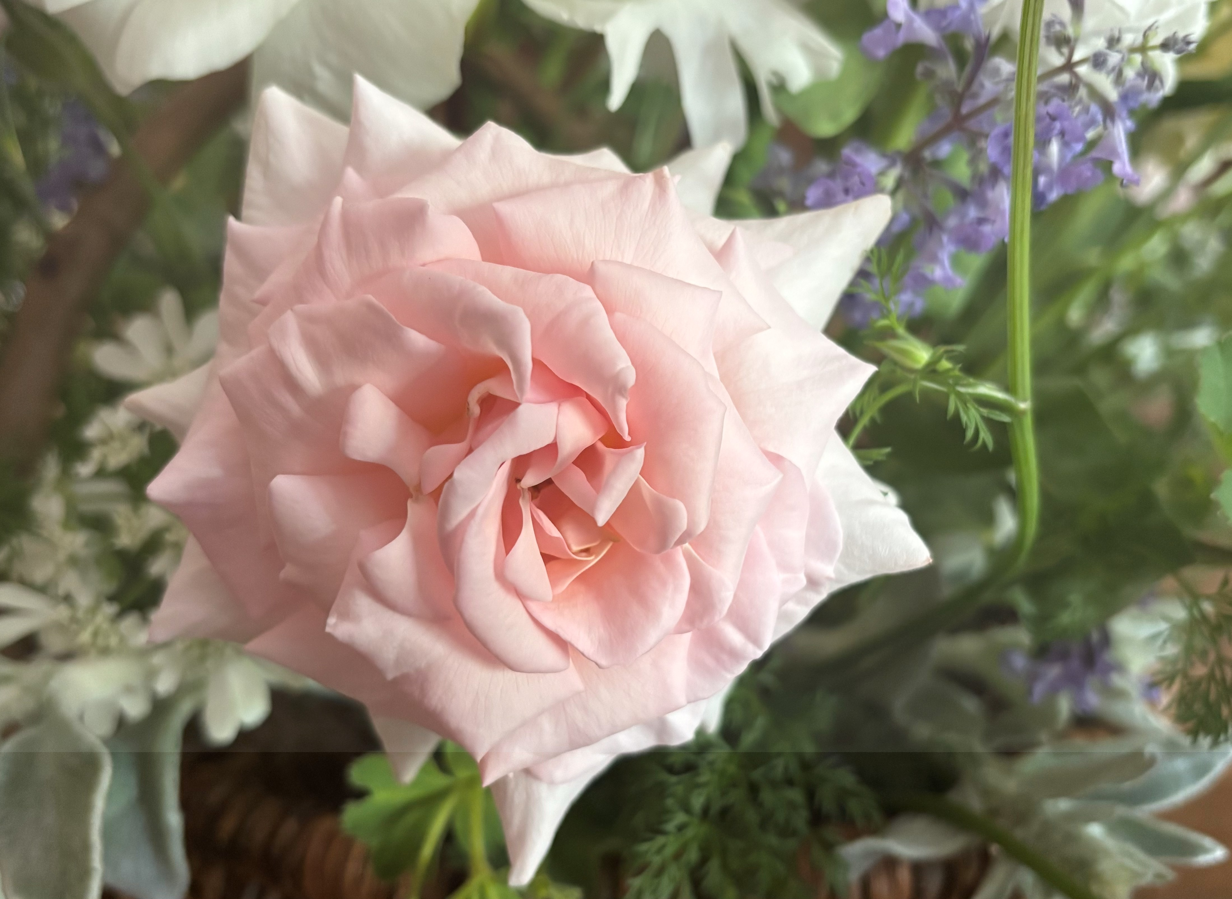
Get in Touch
Blossoms​ & Blooms Floral Studio
07771 951 933
hello@blossomsandbloomsfloralstudio.com
www. blossomsandbloomsfloralstudio.com
www.instagram.com/blossomsandblooms_floralstudio/

